Slide 1
Changing Pages with Routing

Slide 2
What is Routing in Angular?
Routing in Angular refers to the mechanism of navigating between different views or components in a single-page web application.
It allows you to load different content into the same web page without having to perform full page reloads.

Slide 3
Routing in Angular: It's the process of managing and controlling navigation within an Angular application, enabling users to move between different views or components while maintaining a single-page application experience.

Slide 4
In Angular, routing is typically configured using the Angular Router module, and it involves defining routes that map URLs to specific components. When users navigate to a different URL, Angular loads the associated component into the view, providing a seamless and responsive user experience

Slide 5
why do we need a router ?
Multi-Page Feeling in a Single-Page Application (SPA):Most modern web applications are built as SPAs, where the entire page is not reloaded when navigating between views or pages. Instead, only the content that changes is updated.
URL-Based Navigation:A router helps in mapping URLs to specific views or components in your application

Slide 6
Topics
Setting up and Loading Routes
Navigating with Router Links
Understanding Navigation Paths

Slide 7
Relative vs Absolute Path
Relative Path: Describes a location or route based on the current context or location, typically shorter, and doesn't start from the root.
Absolute Path: Specifies a location or route starting from the root or the very beginning, typically longer and complete.

Slide 8
Examples: Relative Path
./home - This specifies a route relative to the current location, such as navigating to a "home" route from the current route.
../about - This specifies a route that goes up one level in the route hierarchy and then navigates to the "about" route.

Slide 9
Examples: Absolute Path
/home - This specifies an absolute route starting from the root of the application, navigating directly to the "home" route.
/products/item - This specifies an absolute route to a deeply nested "item" route, starting from the root.

Slide 10
Styling Active Router Links
Navigating Programmatically.
Using Relative paths in Programmatic Navigation.
Passing Parameters to Routes
Fetching Route Parameters.
Fetching Route Parameters Reactively.

Slide 11
Route Guards
Angular Route Guards can be used to control whether the user can navigate to or away from the given route based on some condition.

Slide 12
Use case of Route Guards
To confirm the navigation operation
Asking whether to save data before moving away from view.
Allow access to certain parts of the application to specific users
Fetching some data before you display the component view.

Slide 13
Types of Route Guards
CanActivate
CanDeactivate
Resolve
CanLoad
CanActivateChild

Slide 14
How to Create a Route Guard
Create a route guard as a Service.
Implement the respective route guard interface.
Implement the required route guard method.
Register the Route Guard In Angular module (usually app.module.ts), add the route guard to the providers array under @NgModule.
Use the route guard on the route which you want to guard.

Slide 15
CanActivate Route Guards
CanActivate is a route guard in Angular that allows you to control whether a user can access a specific route or not. It provides a simple way to enforce authentication and authorization rules for routes.

Slide 16
CanActivate Route Guard: It checks a condition or performs logic to determine if a user is allowed to navigate to a specific route. If the condition is met (e.g., the user is authenticated), the route is allowed; otherwise, access is blocked or redirected (e.g., to a login page).

Slide 17
CanActivateChild Guards
CanActivateChild is a route guard in Angular that allows you to control whether child routes (routes nested within a parent route) can be activated. It is used to guard access to the child routes, ensuring that certain conditions are met before allowing navigation to those routes.

Slide 18
CanDeactivate Guards
A CanDeactivate guard in the context of Angular is a feature that allows you to prevent a user from navigating away from a particular route or component if certain conditions are not met. In simpler terms, it's a mechanism to control whether a user can leave a page or component.

Slide 19
Resolve Guards
A Resolve guard in Angular is a feature used to fetch data or perform an action before a route is activated. It ensures that the necessary data is available and resolved before rendering the component associated with the route.
In simpler terms, a Resolve guard allows you to retrieve data asynchronously and ensure that the data is ready to be used by a component when the route is activated.

Slide 20
Here's an example scenario:
Let's say you have a route that displays details about a product, and you need to fetch product information from a server before displaying the product details page. You can use a Resolve guard to initiate the data-fetching operation and make sure that the product data is available before the component is activated. This ensures that your component doesn't attempt to use the data before it's ready.

Slide 21
Navigating Events in Angular
Enable Tracing for navigation

Slide 22
Observables
Observables are part of the RxJS library and are commonly used in Angular for handling asynchronous data streams.
Observables represent a sequence of values over time, much like a stream of events.
An Observable is like a continuous stream of events or data that you can listen to. It's a way to watch for things that happen over time, and when something does happen, you can react to it.

Slide 23
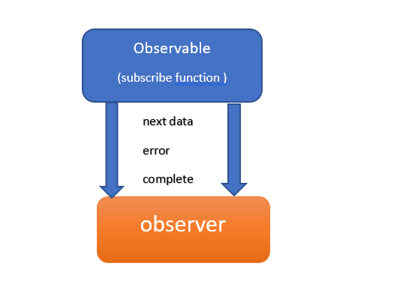

Slide 24
In programming, an Observable is like that TV channel. It emits events or data over time, and your code can subscribe to it to react to those events when they occur. This is particularly useful for handling real-time data, user interactions, and asynchronous operations in a structured and reactive manner.

Slide 25
For example, think of a user clicking a button on a web page multiple times. Each click is an event, and these events occur over time. You can represent this series of click events as a stream of values in an Observable. The Observable emits a value (the click event data) every time a click occurs. Subscribers to the Observable can then react to these events by defining what should happen when a new value is emitted.

Slide 26
Button Click Events:
Imagine you have a web page with a button, and you want to track and react to each click on that button.
You can create an Observable that represents the stream of click events.
Subscribers to this Observable can be notified every time the button is clicked.

Slide 27
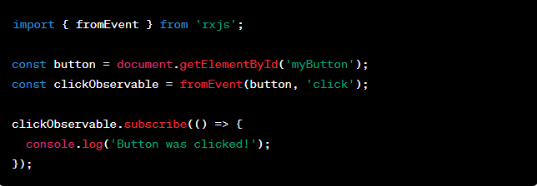
In this example, clickObservable represents a stream of click events on the button, and the subscribe method allows you to react to each click event.

Slide 28
HTTP Requests:
When making HTTP requests to a server, you can use Observables to handle the response data.
The Observable represents the asynchronous request, and subscribers can process the response data when it arrives.

Slide 29
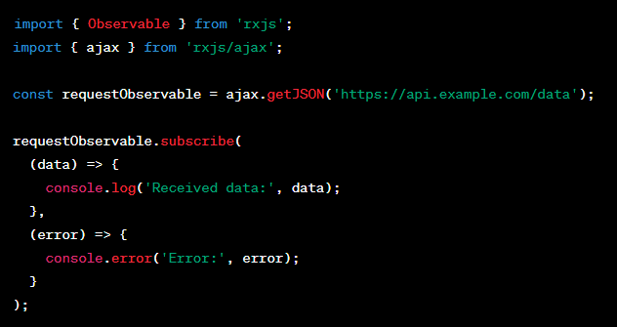
Here, requestObservable represents an HTTP request, and the subscribe method allows you to handle the response data or errors when they occur.

Slide 30
Promise:
A Promise is a built-in JavaScript object introduced in ES6 to handle asynchronous operations.
It represents a value that might not be available yet but will be at some point in the future.
Promises have three states: pending, resolved (fulfilled), and rejected.
You can attach callbacks (.then() and .catch()) to a Promise to handle the success or failure of an asynchronous operation.
Promises are typically used for one-time asynchronous tasks, like fetching data from a server.

Slide 31
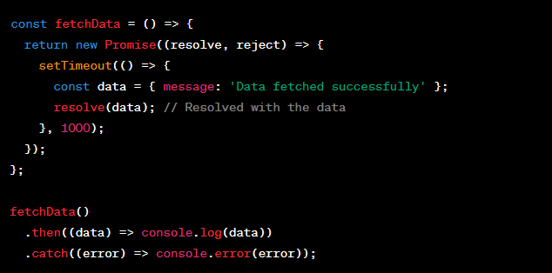

Slide 32
1. Creating a Promise
You can create a new Promise using the Promise constructor. This constructor takes a single function as an argument, which has two parameters: resolve and reject. Inside this function, you perform your asynchronous task and call resolve when the task is successful, or reject if it encounters an error.

Slide 33
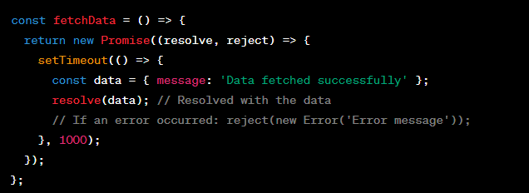
In this example, fetchData returns a Promise that simulates fetching data asynchronously. After 1 second, it resolves with a data object. You can also reject the Promise by calling reject with an error if an error occurs.

Slide 34
2. Consuming a Promise
Once you have a Promise, you can use the .then() method to specify what should happen when the Promise is resolved successfully, and the .catch() method to handle errors.

Slide 35
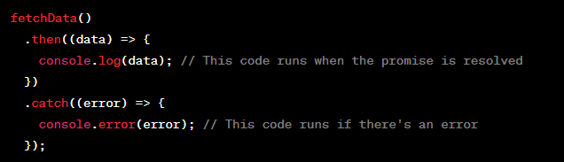
.then() is used to provide a callback function that takes the resolved data as its argument. This callback executes when the Promise is successfully resolved.
.catch() is used to provide a callback function that handles errors if the Promise is rejected.

Slide 36
3. Chaining Promises
Promises can be chained together to perform multiple asynchronous operations in sequence.

Slide 37
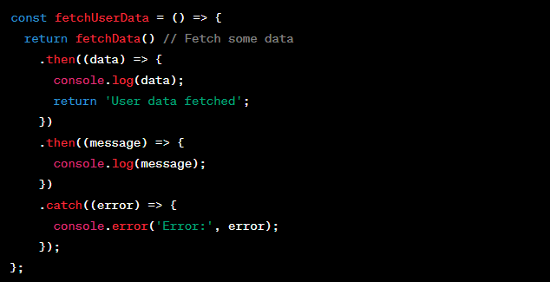
In this example, fetchUserData calls fetchData, processes its result, and then continues with additional steps. Each .then() returns a Promise, allowing you to chain them together.

Slide 38
Subject:
A Subject is a special type of Observable provided by RxJS.
It acts as both an observable and an observer, allowing you to multicast values to multiple subscribers.
Subjects are often used in scenarios where you need to broadcast events or share a single source of truth with multiple consumers.
Subjects have methods like next(), error(), and complete() to manually emit values, errors, and completion notifications.

Slide 39
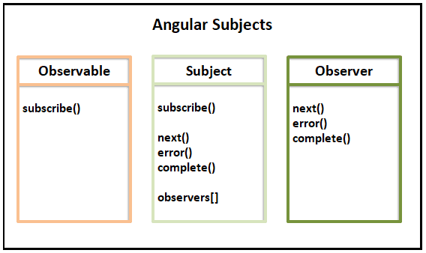
How does Subjects work
Subjects implement both subscribe method and next, error & complete methods. It also maintains a collection of observers[]

Slide 40
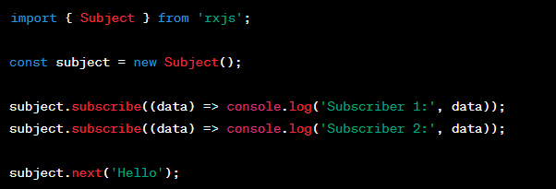

Slide 41
Here are some real-time differences between Promises, Observables, and Subjects

Slide 42
1. Promises:
Use Case: Promises are ideal for handling single asynchronous operations that have a one-time resolution, such as fetching data from an API.
Example: Suppose you're fetching user information from an API:

Slide 43
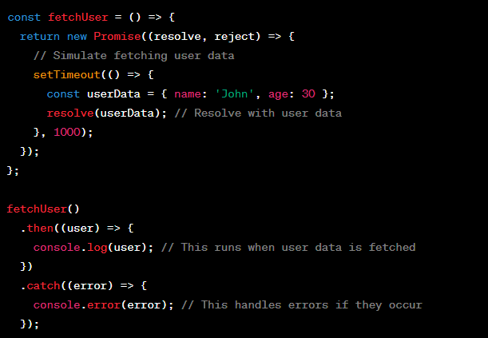

Slide 44
2. Observables:
Use Case: Observables are suitable for handling continuous streams of data or events over time, such as real-time updates in a chat application.
Example: Imagine you have a chat application that receives messages in real-time:

Slide 45
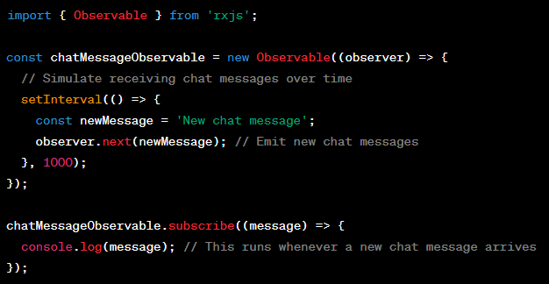

Slide 46
3. Subjects:
Use Case: Subjects are like a bridge between Promises and Observables. They can multicast values to multiple subscribers and are often used when you need to share a single source of data among multiple consumers.
Example: Consider an application where multiple components need to access and update shared data:

Slide 47
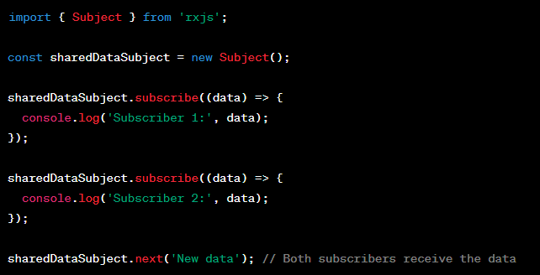
In this example, both Subscriber 1 and Subscriber 2 receive the same data when it's emitted, making Subjects useful for sharing data among different parts of an application.

Slide 48
Summary..
Promises: Used for doing something that takes time and will give you one result.
Example: Making an HTTP request to a server to fetch a single piece of information, like retrieving a weather forecast for a specific location. You make the request, wait for the response, and once you receive it, you have the weather forecast.

Slide 49
Observables: Used for watching something that changes over time and may give you many results (like watching a live sports game with multiple updates).
Subjects: Used for sharing updates with many people at once, like sending a message to a group chat.

